Slide 1
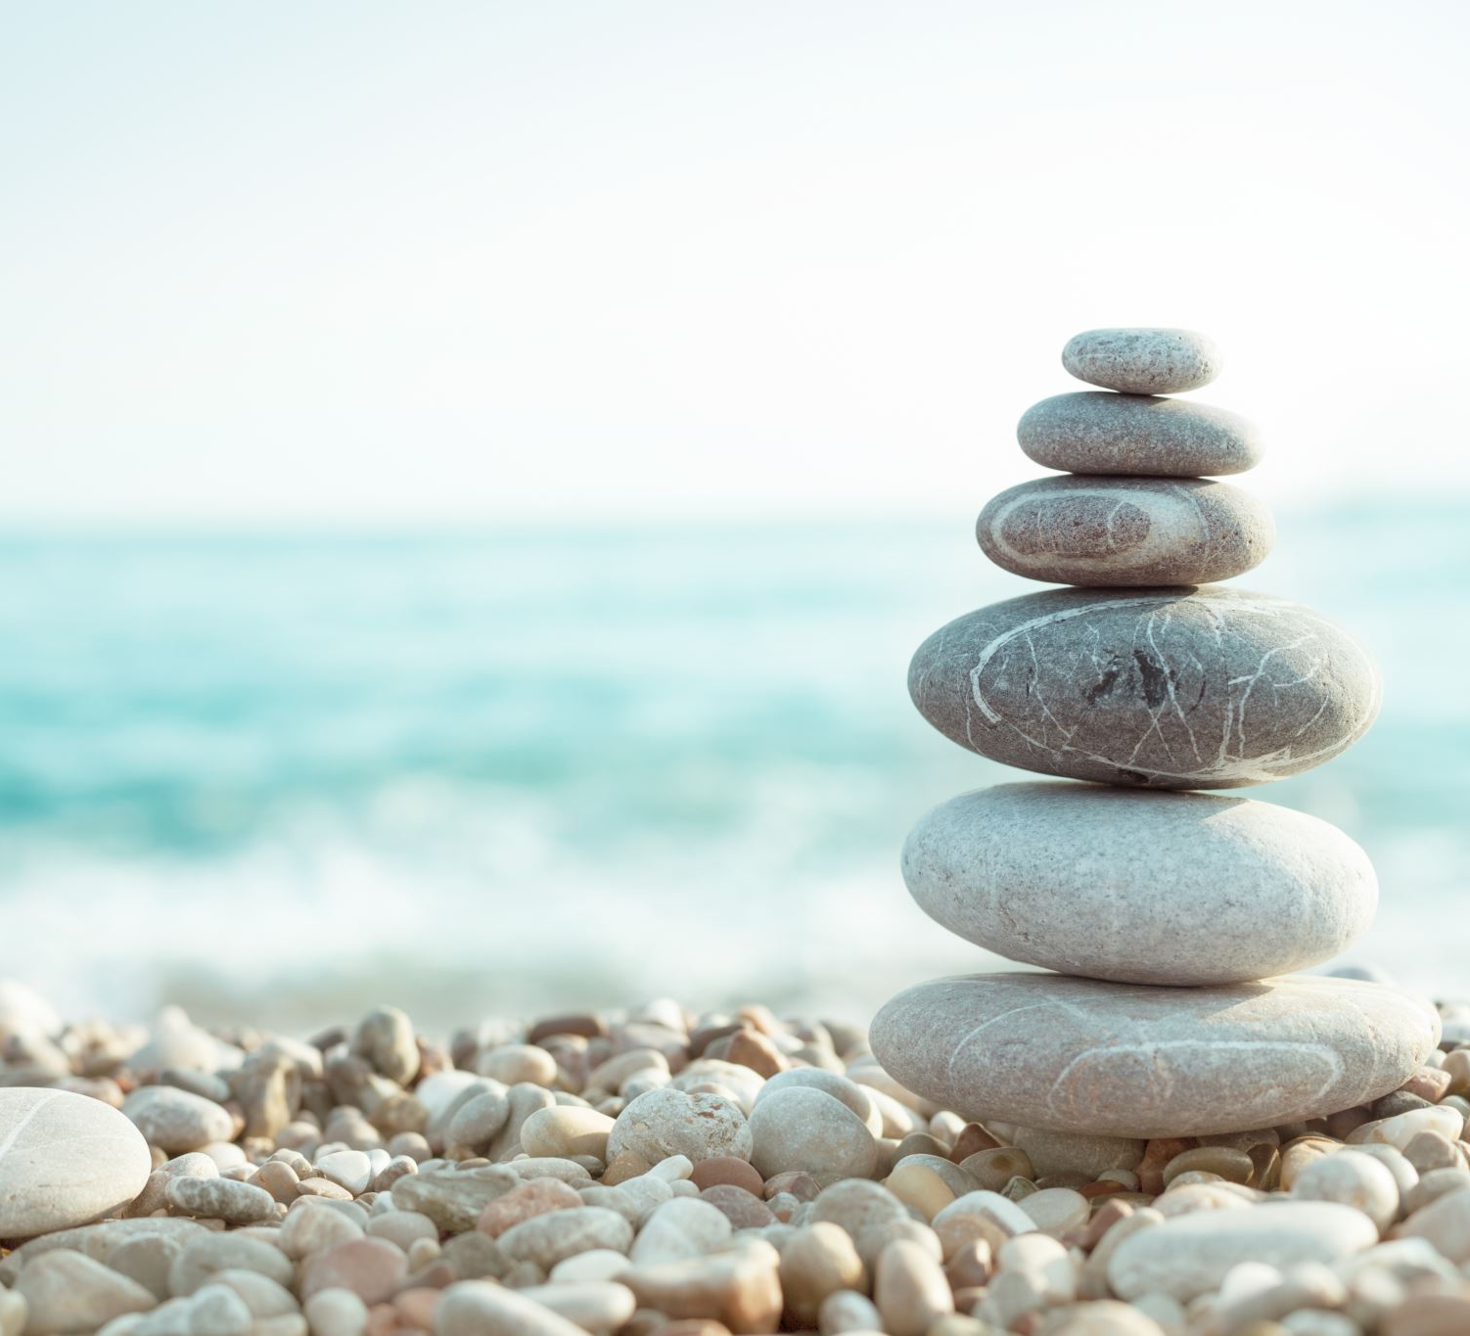
Meditation and Relaxation Guide

Slide 2
So many people suffer with an overactive mind and thought process, so I have put together a Meditation and Relaxation guide to help you completely relax and start to bring some calmness into your life. This will really help your mind, concentration and overall general health and well-being. If you feel like you are not coping with life and the stresses of your demanding job is to much, then try this technique. Gather all your thoughts, put them in a bubble and blow them away with your out breath. Say to yourself, 'relax, refresh, recharge'. One of my favourite quotes from Bryant Mcgill is, 'Your calm mind is the ultimate weapon against your challenges. So, relax.’ To me this sums up every day challenges especially meeting deadlines. You need a calm mind to see through and past the challenges we face every day, especially if you are sleep deprived due to the high demands of your stressful job.

Slide 3
Method
Come to a seated or laying down position. If seated, get comfortable and have hands resting wherever is comfortable. If laying down, have your feet more than hip distance apart, hands down by your sides slightly away from your chest, having the palms facing towards the sky. Gently push your shoulders down away from your ears and tilt your head so your chin is slightly facing towards the chest. This will lengthen the spine. Gently close your eyes and bring the tongue away from the roof of your mouth. Have your jaw slightly open, releasing tension in your face. Move any part of your body you need to, to feel comfortable. You need to fully release all the muscles. Fully release all the thoughts. Fully release all the tension kept in your body. Have a wriggle, have a giggle and then settle down to your final comfortable relaxation state.
Slowly start to gather your thoughts, collecting them all up and putting them in a bubble and blowing them away with your exhale. Any other thoughts that come your way, let them go. Let them just drift past, trying not to cling onto them. You want your mind and body to be completely still.
Be conscious of your breathing for three deep breaths. Inhale using your diaphragm. Try breathing from the bottom of your tummy right up to the top of your collar bone. You are aiming to fully inflate your lungs. Gently push your shoulder blades down into the floor, spreading them away from your ears and away from the spine. On every inhale slightly pause at the top before your exhale. Do not pause if you have high blood pressure.
On your exhales you are aiming to slowly release from the tops of your collar bone, down through the chest, using your core muscles to push out all the extra air. Slowly count to three on the inhales and four on the exhales. On the inhale say to yourself, ‘let’ and on your exhales say to yourself, ‘go’. Listen to your body and feel it releasing. Releasing tension all over your body.
Find your final relaxation state.
Notice your breath’s natural rhythm, allowing the tummy to rise and fall naturally.

Slide 4
Starting at the tips of your toes and working all the way to the crown of the head, relax all the muscles and bones in your body. Imagine the muscles peeling away from the bones. Relaxing.
Slowly relaxing the soles of the feet, ankles, calves and shins. Relax the knees, knee caps, back of knees. Relax your thighs (quads and hamstrings). Bring your attention towards the front of your pelvis and start to relax. Relax the hip joints, the front and back of the pelvis. The top and bottom of the pelvis. There is so much tension kept in the pelvis area. Breathe into the area deeply. Relax the lower spine, feeling the back muscles peeling away from it. Bring your attention around to the front of your body. Relax your internal organs, your tummy area. Relax the middle of your spine, chest ribs, the muscles in between the ribs (intercostal muscles). Relax the top of your spine. The collar bones. Bring your attention to the shoulder blades. Relax the shoulders. Relax your upper arms (triceps and biceps). Relax your elbows, forearms, wrists, hands and fingers. Imagine someone lifting your arm up and releasing it to the floor. It would be so heavy that it would fall quickly. Bring your attention towards the back of the neck, relaxing the muscles. The front of the neck, relaxing the thyroid glands, voice box. Relax your head. Feeling your head heavy, sinking into the floor. Bring your attention to your face. Relax your forehead, eyes, cheek bones, jaw. Finally relaxing your mind.
Stay here for as long as you need to. Breathing in and out. Clearing your mind.

Slide 5
Visualisation
Visualisation – When fully relaxed, slowly start to visualise yourself marooned on a deserted beach. No one else around but you. Sitting under a palm tree gazing out to the crystal-clear waters of the ocean. Imagine the colours around you. Bright blue sky, green palm tree leaves, white soft sand. Imagine picking up the nice white soft sand and letting it run through your fingers and toes. Noticing how soft and pure it feels. Noticing the gentle breeze on your skin, the warm sun beaming down on you. Letting all your thoughts and worries go. Listening to the waves gently lapping on the shore. Just feeling calm, relaxed, being present in this present moment.
You may want to take a walk down to the ocean. Slowly get up from where you are sitting under your palm tree. Walk down to the ocean feeling the white soft sand between your toes. Feeling the warm sun still beaming down on you. Maybe picking up some shells as you go. As you reach the shoreline, slowly take a paddle into the shallow water. Noticing the coolness of the ocean around your feet and ankles. Watching little fish swim around your feet. Feeling your feet sinking into the sand. Maybe stay here or take a walk through the water. Just walking gently. Noticing your feelings. How calm, relaxed and heavy the body feels. Stay here for as long or as little as you wish. Start to slowly walk back up the beach, feeling the soft sand around your toes. Gently sit back down under your palm tree. Still gazing out to the ocean. Noticing how calm and relaxed you are.

Slide 6
You may want to take a walk down to the ocean. Slowly get up from where you are sitting under your palm tree. Walk down to the ocean feeling the white soft sand between your toes. Feeling the warm sun still beaming down on you. Maybe picking up some shells as you go. As you reach the shoreline, slowly take a paddle into the shallow water. Noticing the coolness of the ocean around your feet and ankles. Watching little fish swim around your feet. Feeling your feet sinking into the sand. Maybe stay here or take a walk through the water. Just walking gently. Noticing your feelings. How calm, relaxed and heavy the body feels. Stay here for as long or as little as you wish. Start to slowly walk back up the beach, feeling the soft sand around your toes. Gently sit back down under your palm tree. Still gazing out to the ocean. Noticing how calm and relaxed you are.

Slide 7
As you slowly start to bring your mind back into the room, gently wriggling your fingers and toes bringing the sensation back into your body. Maybe hug your knees into your chest or have a stretch and a yawn. Bring the right arm up above your head and slowly, when you are ready, roll onto your right side, resting your head on your arm. Stay here for as long as you wish. Noticing how relaxed, calm and heavy your body feels. When you are ready, push up to a comfortable seated position, hands resting wherever is comfortable.
We are going to take three long big deep breaths. Slowly inhale and slowly exhale. On the second breath inhale to fully expand your lungs, pausing at the top only if this is comfortable and then on the exhale really releasing any tension held here. On your last breath, take a big deep inhale using all your lung capacity and a bit more. On your exhale let out a big sigh. Noticing how your body feels after your relaxation and breathing.
You are now free to carry on with your day, or if practicing this at night, rest soundly feeling calm, relaxed and rested.
Namaste xxx
‘Here sleeps a girl with a heart full of magical dreams,
A heart full of wonder,
And hands that will shape the world.’

